Slide 1
Investigation Task
Year 7 Science

Slide 2
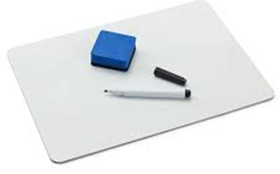
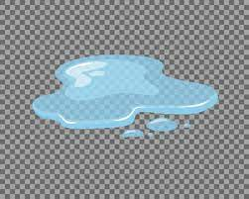
Review:
Draw a scientific diagram of a test tube.
When you light a Bunsen burner, should the air hole be open or closed?
You observed a puddle of clear liquid on the bench. Write an inference and a prediction to go with this observation.
Caption this diagram:

Slide 3
Learning Intentions
Collaboratively and individually plan and conduct a range of investigation types, including fieldwork and experiments, ensuring safety and ethical guidelines are followed

Slide 4
Success criteria
Calculate averages from repeat trials
Graph your results
Start (finish) your discussion
(if your whole group finishes today you can do an experiment tomorrow).

Slide 5
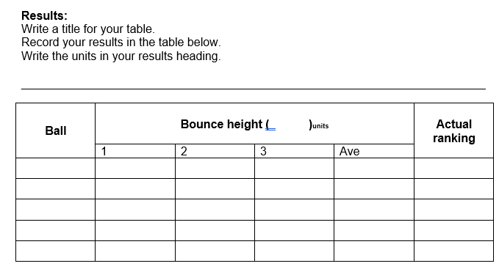

Slide 6
Calculating averages

Slide 8
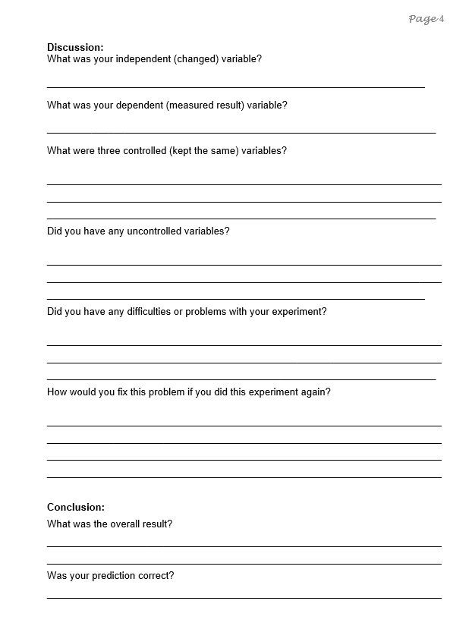

Slide 9
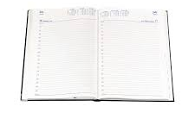
Don’t forget
Homework sheet – Analysing graphs
Due Monday 26 Feb

